Slide 1


Uncover
Your Business Potential
Brett Davidson
Founder

Slide 2


Uncover
Your Business Potential
Welcome
Review of Days 1, 2, 3, 4, & 5
Creating a killer ongoing review service
An excellent annual review process

Slide 3

Review

Slide 4


Have you conducted your own Quarterly Review session?

Slide 5
Did you analyse your financials using the Quarterly MI Spreadsheet?
What did you discover about your business?

Slide 6

Creating
A Killer Ongoing Review Service

Slide 7

Creating A Killer Ongoing Review Service
Lifetime value of the client
Example:
- £1,000 pa x 25 yrs = £25,000
- £5,000 pa x 20 yrs = £100,000
How many clients do you lose each year?

Slide 8
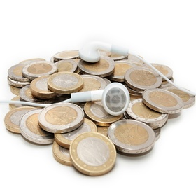
Creating A Killer Ongoing Review Service
Low value firms
Survive, but with a weak offering
Can’t justify charging a premium price (e.g. 1% pa)
Fees are charged for managing the client money
Make little genuine profit after owners’ & advisers’ remuneration
The business itself is worthless
The client bank may have some value (arbitrage value)

Slide 9

Creating A Killer Ongoing Review Service
High value firms
Fees are for delivering lifestyle outcomes for clients
Can & do charge a premium price (e.g. 1% pa)
Make genuine net profit (after owners’ & advisers’ remuneration) of 25%+ pa
Deliver a systemised client experience
The business has real value

Slide 10

“
A key component of the difference between these types of firms is the quality of their review service
”

Slide 11

In high value firms the lifetime value of each client is much greater & therefore so is the business value

Slide 12

“
This all stems from creating an amazing client review service
”

Slide 13

The Client View

Slide 14

Creating A Killer Ongoing Review Service
Business Health CATScan™
Surveyed over 60,000 clients around the world
Results:
Clients rate the review process 10/10
Clients rate what they actually receive 3/10
Why the discrepancy?

Slide 15

What makes an
amazing client review service?

Slide 16

Let’s look first
at what doesn’t

Slide 17
What’s Not An Amazing Client Review Service?
Talking about investments
Cup of tea and a chat
Anything that doesn’t deliver what the client actually wants

Slide 18

So, what does make an amazing client review service?

Slide 19

Only two things

Slide 20

1
Show me that everything is going to be alright
(and if it’s not, tell me what to do about it)

Slide 21

2
Politely remind me what you’ve done for me lately

Slide 22

Ask yourself the question –
“
Does my existing approach achieve these two objectives?
”

Slide 23

Number 1
is more important by a factor of 10
(This is the cake)

Slide 24

If all you ever did was deliver point 1.
you would have a great and thriving business

Slide 25

Number 2
is more important for you
(It’s the icing on the cake)

Slide 26

How do you ‘show’ people that
everything is going to be alright?

Slide 27

Delivering Outcomes

Slide 28

Example 1:
Client arrives
They have enough money
(which you proved using a cashflow model previously)
You update their cashflow model with latest figures
You modify your underlying assumptions
You show them they still won’t run out of money before 100 years of age

Slide 29

Job done

Slide 30

Example 2:
Client arrives
They have enough money
(which you proved using a cashflow model previously)
You update their cashflow model with latest figures
You modify your underlying assumptions
You show them they still won’t run out of money before 100 years of age
They mention they want to gift son/daughter £100k
The real question is “Can we afford it?”

Slide 31

Example 2:
You re-run their numbers while they are there
You show them they can afford it
But you suggest making it a loan not a gift
And recommend drafting a simple loan agreement

Slide 32
Job done

Slide 33

Example 3:
Client arrives
They had enough money but were marginal
(which you proved using a cashflow model previously)
There has been a major market crash (falling 50%)
The client is terrified & their portfolio has fallen 23%
You update their cashflow model with latest figures
You modify your underlying assumptions
You show them what adjustments to spending they need to make to still be ok in the long run

Slide 34
Job done

Slide 35

Demonstrating Your Value Added
(the icing on the cake)

Slide 36

What is
value?

Slide 37

How do you
identify & demonstrate it?

Slide 38

The Value Added Checklist
Investment (extra returns, costs saved)
Tax savings (IHT, Pension, CGT, PAYE/NI)
Insurance
Debt
Estate planning
Problems avoided
Other professionals
Administration hassle
Etc

Slide 39

Let’s do an exercise

Slide 40

What if you
don’t add value
every year?

Slide 41

What if you
don’t add value
at all?

Slide 42

Spice up your review meetings with some power questions

Slide 43
Other Review Tools
The Worm (use Cashflow)
The 12 Point Financial Health Check
The Scorecard
The Adviser Toolkit

Slide 44
12 Point Financial Health Check

Slide 45
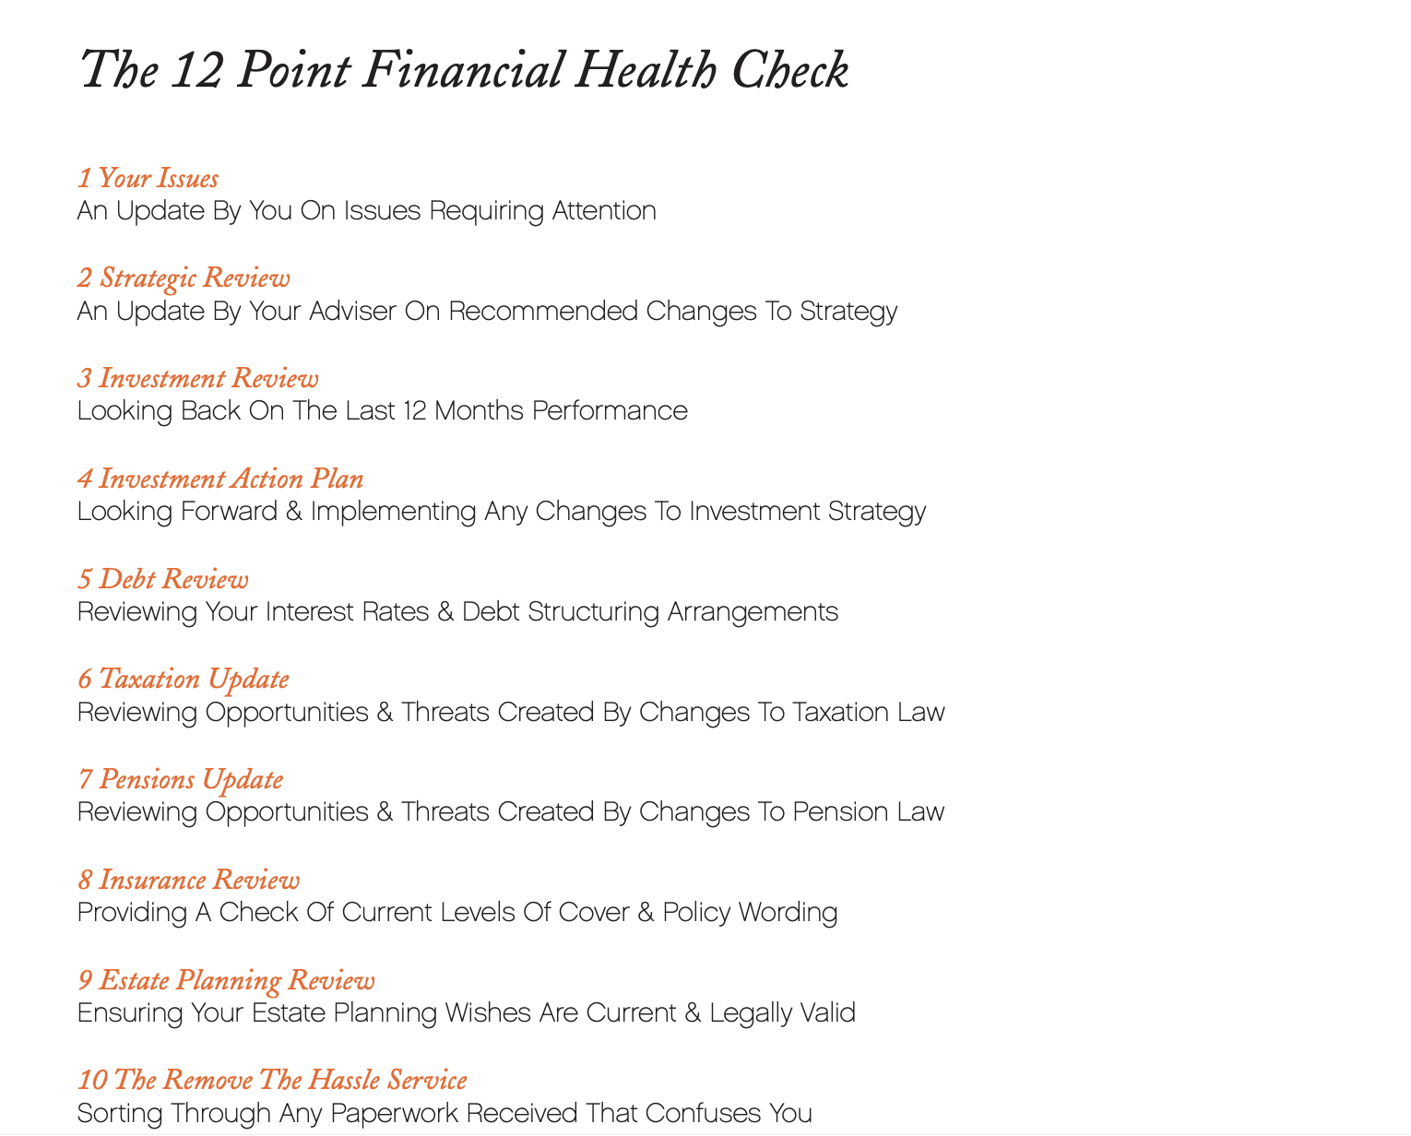
The 12 Point Financial Health Check

Slide 46

Don’t mail
or email this out prior to your meeting

Slide 47

Do just place it
on the table
in front of you and your client at the start of the meeting

Slide 48
“
Shall we get down to business?
”

Slide 49

The 12 Point Financial Health Check
1
Your Issues
An Update By You On Issues Requiring Attention

Slide 50

The 12 Point Financial Health Check
1
Your Issues
An Update By You On Issues Requiring Attention
2
Strategic Review
An Update By Your Adviser On Recommended Changes To Strategy

Slide 51

The 12 Point Financial Health Check
1
Your Issues
An Update By You On Issues Requiring Attention
2
Strategic Review
An Update By Your Adviser On Recommended Changes To Strategy
3
Investment Review
Looking Back On The Last 12 Months Performance

Slide 52

The 12 Point Financial Health Check
1
Your Issues
An Update By You On Issues Requiring Attention
2
Strategic Review
An Update By Your Adviser On Recommended Changes To Strategy
3
Investment Review
Looking Back On The Last 12 Months Performance
4
Investment Action Plan
Looking Forward & Implementing Any Changes To Investment Strategy

Slide 53

The 12 Point Financial Health Check
5
Debt Review
Reviewing Your Interest Rates & Debt Structuring Arrangements

Slide 54
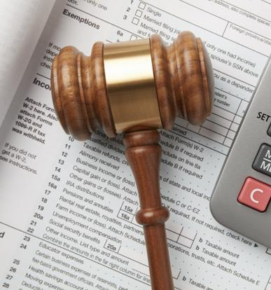
The 12 Point Financial Health Check
5
Debt Review
Reviewing Your Interest Rates & Debt Structuring Arrangements
6
Taxation Update
Reviewing Opportunities & Threats Created By Changes To Taxation Law

Slide 55

The 12 Point Financial Health Check
5
Debt Review
Reviewing Your Interest Rates & Debt Structuring Arrangements
6
Taxation Update
Reviewing Opportunities & Threats Created By Changes To Taxation Law
7
Pensions Update
Reviewing Opportunities & Threats Created By Changes To Pension Law

Slide 56

The 12 Point Financial Health Check
5
Debt Review
Reviewing Your Interest Rates & Debt Structuring Arrangements
6
Taxation Update
Reviewing Opportunities & Threats Created By Changes To Taxation Law
7
Pensions Update
Reviewing Opportunities & Threats Created By Changes To Pension Law
8
Insurance Review
Providing A Check Of Current Levels Of Cover & Policy Wording

Slide 57

The 12 Point Financial Health Check
9
Estate Planning Review
Ensuring Your Estate Planning Wishes Are Current & Legally Valid

Slide 58

The 12 Point Financial Health Check
9
Estate Planning Review
Ensuring Your Estate Planning Wishes Are Current & Legally Valid
10
The Remove The Hassle Service
Sorting Through Any Paperwork Received That Confuses You

Slide 59

The 12 Point Financial Health Check
9
Estate Planning Review
Ensuring Your Estate Planning Wishes Are Current & Legally Valid
10
The Remove The Hassle Service
Sorting Through Any Paperwork Received That Confuses You
11
Family Review
Discussing Any Financial Issues Affecting Your Family

Slide 60

The 12 Point Financial Health Check
9
Estate Planning Review
Ensuring Your Estate Planning Wishes Are Current & Legally Valid
10
The Remove The Hassle Service
Sorting Through Any Paperwork Received That Confuses You
11
Family Review
Discussing Any Financial Issues Affecting Your Family
12
Professional Update
Providing Professional Updates To Your Accountant & Other Advisers

Slide 61
12. Professionals Update
You
(to the client)
“Would it be helpful if I contacted your accountant and gave them an update on the tweaks we’ve made to your financial plan as a result of this review?”

Slide 62
12. Professionals Update
You
(to the client)
“Would it be helpful to you if I contacted your accountant and gave them an update on the tweaks we’ve made to your financial plan as a result of this review?”
You
(to the accountant)
“We’ve got a mutual client, Mr and Mrs X. They asked me to give you an update on a few changes we’ve made to their financial plan. I wondered if I can come and see you for 15 or 20 minutes and take you through what we’ve done. I want to be sure that any changes we’re recommending sit right with the structures you’ve put in place for them.”

Slide 63

Some Dos and Don’ts

Slide 64
Don’t mail
or email this out prior to your meeting

Slide 65
Do just place it
on the table
in front of you and your client at the start of the meeting

Slide 66

Don’t customise it
for each client

Slide 67

Do skip over sections
that are not relevant to that particular client

Slide 68

Don’t send meeting notes to clients
after the review meeting

Slide 69

Do send a bullet point email
that summarises what you agreed and who is to do what

Slide 70
12 Point Financial Health Check

Slide 71

It makes what you do tangible

Slide 72

There’s one more reason
I like this approach…

Slide 73
The One Page Scorecard

Slide 74

We hired a Practice Manager...

Slide 75
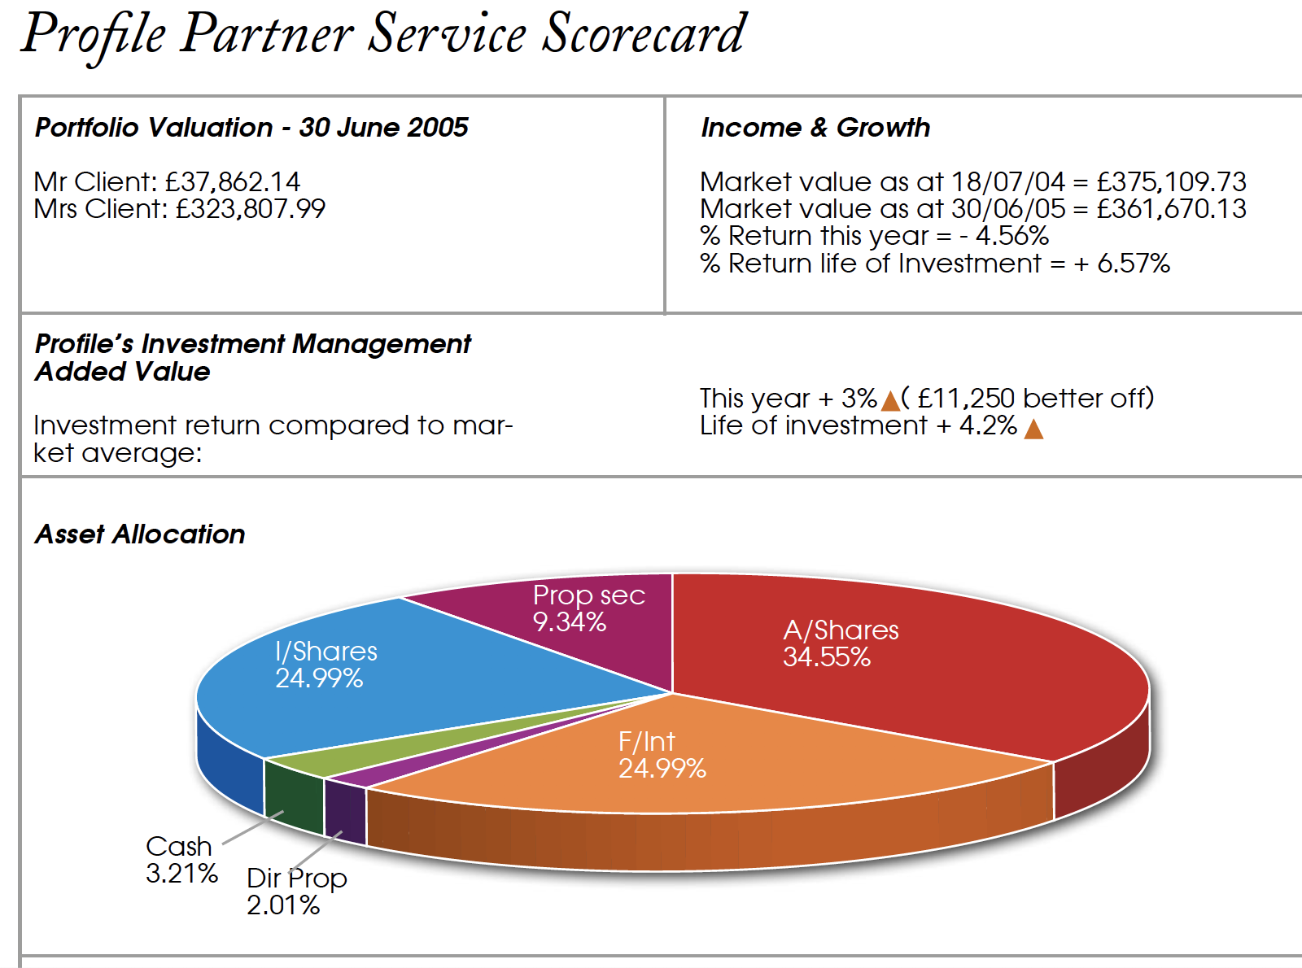
The One Page Scorecard

Slide 76
The One Page Scorecard

Slide 77
The One Page Scorecard

Slide 78
The One Page Scorecard

Slide 79
The One Page Scorecard

Slide 80
The One Page Scorecard

Slide 81
Client with £1M invested
0.5% pa fee saving = £5,000
£5,000 pa X 10 years = £50,000

Slide 82
The One Page Scorecard

Slide 83
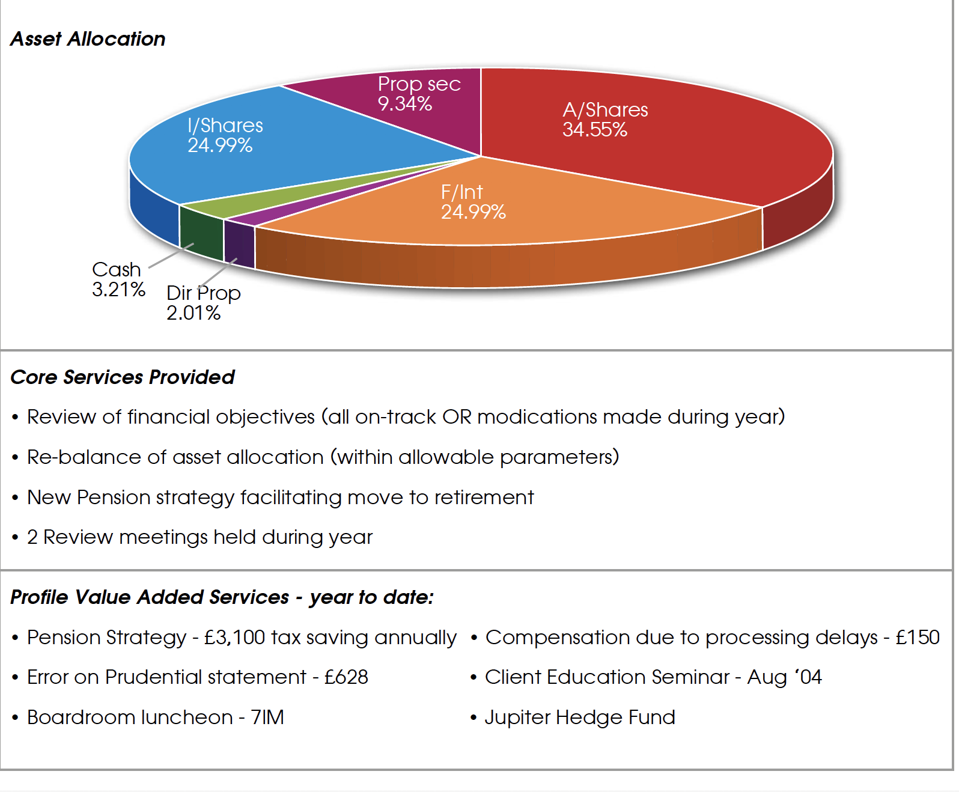
The One Page Scorecard

Slide 84
The One Page Scorecard

Slide 85
The One Page Scorecard

Slide 86
The One Page Scorecard

Slide 87
The One Page Scorecard

Slide 88
The One Page Scorecard

Slide 89
The One Page Scorecard

Slide 90
The One Page Scorecard

Slide 91
The One Page Scorecard

Slide 92
The One Page Scorecard

Slide 93
The One Page Scorecard

Slide 94
The One Page Scorecard

Slide 95
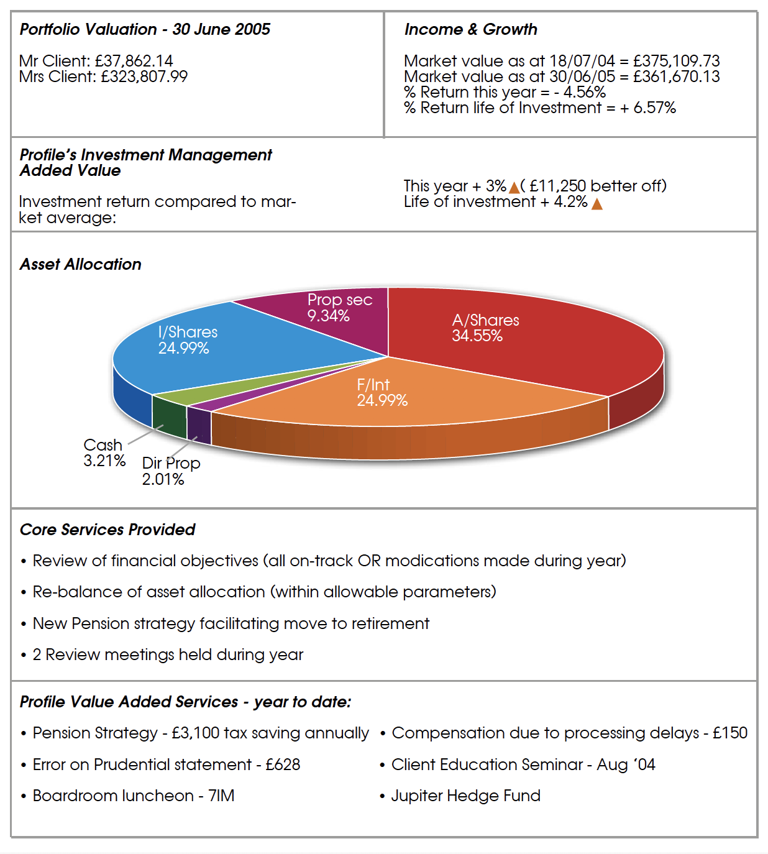
The One Page Scorecard

Slide 96

The One Page Scorecard
Value Added:
Investment value added £11,250
Pension tax savings £ 3,100
Error on Prudential statement £ 628
Compensation for delay £ 150
Total £15,128

Slide 97
The One Page Scorecard
Value Added:
Investment value added £11,250
Pension tax savings £ 3,100
Error on Prudential statement £ 628
Compensation for delay £ 150
Total £15,128

Slide 98
The One Page Scorecard
Value Added:
Investment value added £11,250
Pension tax savings £ 3,100
Error on Prudential statement £ 628
Compensation for delay £ 150
Total £ 3,878

Slide 99
The Value Added Conversation
Me
“One of the things we do internally for each client review, is work out how much the client has paid us, and how much value we can identify in cash, that we’ve been able to put back in their pocket each year.”
The Client

Slide 100
The Value Added Conversation
Me
“One of the things we do internally for each client review, is work out how much the client has paid us, and how much value we can identify in cash, that we’ve been able to put back in their pocket each year.”
Me
“One of our clients saw it in his file and said we should be showing it to clients at review time. So let me show you your calculation.”
The Client

Slide 101
The Value Added Conversation
Me
“One of the things we do internally for each client review, is work out how much the client has paid us, and how much value we can identify in cash, that we’ve been able to put back in their pocket each year.”
Me
“One of our clients saw it in his file and said we should be showing it to clients at review time. So let me show you your calculation.”
The Client
You
“Mr and Mrs Client how much do you pay me each year to look after your affairs?”

Slide 102
Problems Avoided
The Client
“We can’t remember.”

Slide 103
Problems Avoided
The Client
“We can’t remember.”
Me
“It’s in the ballpark of £3,750 this year. ”

Slide 104
Problems Avoided
The Client
“We can’t remember.”
Me
“It’s in the ballpark of £3,750 this year. ”
The Client
“Really?”

Slide 105
Problems Avoided
The Client
“We can’t remember.”
Me
“It’s in the ballpark of £3,750 this year. ”
The Client
“Really?”
Me
“That’s right. And how much cash have we put back in your pocket this year?”

Slide 106
Problems Avoided
The Client
“We can’t remember.”
Me
“It’s in the ballpark of £3,750 this year. ”
The Client
“Really?”
Me
“That’s right. And how much cash have we put back in your pocket this year?”
Me
“Let me help you. It’s about £3,878”

Slide 107
1
Show me that everything is going to be alright
(and if it’s not, tell me what to do about it)

Slide 108
There’s some homework to do

Slide 109

The Scorecard - Homework
1
Create Your Own Scorecard
Use my Scorecard as a starting idea and customise yours to suit the areas you want to focus on.
2
Trial It With A Friendly Client (Or Two)
Tell them it’s a prototype and ask for some feedback.
3
Refine It
Continue to tweak it until it’s right for you.

Slide 110
The Adviser Toolkit

Slide 111

When sitting across the table from a client…
be ready for anything

Slide 112
Some topics can come up anywhere; for example, investment type questions

Slide 113

The Adviser Toolkit
Investment Strategy
The Science of Investing
Re-Weighting to Benchmark
Understanding Risk
Big Picture
Does It Work?
What We Recommend!

Slide 114

If a plumber comes to your house, they carry a toolkit…
Spanners
Wrenches
Seals
Pipes
Oxy Acetylene blow torch

Slide 115
Leaky tap...
Spanners
Wrenches
Seals
Pipes
Oxy Acetylene blow torch
Use these tools

Slide 116

The adviser toolkit is like the plumber’s toolkit
(but for advisers)

Slide 117
The Adviser Toolkit
Investment Strategy
The Science of Investing
Re-Weighting to Benchmark
Understanding Risk
Big Picture
Does It Work?
What We Recommend!

Slide 118
The Adviser Toolkit
Investment Strategy
The Science of Investing
Re-Weighting to Benchmark
Understanding Risk
Big Picture
Does It Work?
What We Recommend!

Slide 119

The Big Picture

Slide 120
Remember the Parameters ?
INVESTMENT
TYPES
INVESTOR PROFILE
CONSERVATIVE
BALANCED
AGGRESSIVE
Cash
Fixed Interest
70%
30%
0%
Property Trusts
Aust. Shares
Int. Shares
30%
70%
100%
EXPECTATIONS
RETURNS
Negative Returns
1 in 18 yrs
1 in 7 yrs
1 in 5 yrs
Earnings
-7.6% to 35.7%
-23.7% to 44.6%
-34.1% to 56.6%

Slide 121
Remember the Parameters ?
INVESTMENT
TYPES
INVESTOR PROFILE
CONSERVATIVE
BALANCED
AGGRESSIVE
Cash
Fixed Interest
70%
30%
0%
Property Trusts
Aust. Shares
Int. Shares
30%
70%
100%
EXPECTATIONS
RETURNS
Negative Returns
1 in 18 yrs
1 in 7 yrs
1 in 5 yrs
Earnings
-7.6% to 35.7%
-23.7% to 44.6%
-34.1% to 56.6%

Slide 122
Remember the Parameters ?
INVESTMENT
TYPES
INVESTOR PROFILE
CONSERVATIVE
BALANCED
AGGRESSIVE
Cash
Fixed Interest
70%
30%
0%
Property Trusts
Aust. Shares
Int. Shares
30%
70%
100%
EXPECTATIONS
RETURNS
Negative Returns
1 in 18 yrs
1 in 7 yrs
1 in 5 yrs
Earnings
-7.6% to 35.7%
-23.7% to 44.6%
-34.1% to 56.6%

Slide 123
Remember the Parameters ?
INVESTMENT
TYPES
INVESTOR PROFILE
CONSERVATIVE
BALANCED
AGGRESSIVE
Cash
Fixed Interest
70%
30%
0%
Property Trusts
Aust. Shares
Int. Shares
30%
70%
100%
EXPECTATIONS
RETURNS
Negative Returns
1 in 18 yrs
1 in 7 yrs
1 in 5 yrs
Earnings
-7.6% to 35.7%
-23.7% to 44.6%
-34.1% to 56.6%

Slide 124
Remember the Parameters ?
INVESTMENT
TYPES
INVESTOR PROFILE
CONSERVATIVE
BALANCED
AGGRESSIVE
Cash
Fixed Interest
70%
30%
0%
Property Trusts
Aust. Shares
Int. Shares
30%
70%
100%
EXPECTATIONS
RETURNS
Negative Returns
1 in 18 yrs
1 in 7 yrs
1 in 5 yrs
Earnings
-7.6% to 35.7%
-23.7% to 44.6%
-34.1% to 56.6%

Slide 125
Remember the Parameters ?
INVESTMENT
TYPES
INVESTOR PROFILE
CONSERVATIVE
BALANCED
AGGRESSIVE
Cash
Fixed Interest
70%
30%
0%
Property Trusts
Aust. Shares
Int. Shares
30%
70%
100%
EXPECTATIONS
RETURNS
Negative Returns
1 in 18 yrs
1 in 7 yrs
1 in 5 yrs
Earnings
-7.6% to 35.7%
-23.7% to 44.6%
-34.1% to 56.6%

Slide 126
THE BIG PICTURE
Short term
January 1973 - 2 years on
100,000
95,000
90,000
85,000
80,000
75,000
70,000
65,000
60,000
Jan Jan Jan
73 74 75

Slide 127
THE BIG PICTURE
Short term
January 1973 - 2 years on
100,000
95,000
90,000
85,000
80,000
75,000
70,000
65,000
60,000
Jan Jan Jan
73 74 75

Slide 128
THE BIG PICTURE
Short term
January 1973 - 2 years on
100,000
95,000
90,000
85,000
80,000
75,000
70,000
65,000
60,000
Jan Jan Jan
73 74 75

Slide 129
THE BIG PICTURE
Short term
January 1973 - 2 years on
100,000
95,000
90,000
85,000
80,000
75,000
70,000
65,000
60,000
Jan Jan Jan
73 74 75

Slide 130
THE BIG PICTURE
Short term
January 1973 - 2 years on
100,000
95,000
90,000
85,000
80,000
75,000
70,000
65,000
60,000
Jan Jan Jan
73 74 75

Slide 131
THE BIG PICTURE
Short term
January 1973 - 2 years on
Long term
January 1973 - 10 years on
260,000
240,000
220,000
200,000
180,000
160,000
140,000
120,000
100,000
80,000
60,000
100,000
95,000
90,000
85,000
80,000
75,000
70,000
65,000
60,000
Jan Jan Jan
73 74 75
Jan Jan Jan Jan Jan Jan
73 75 77 79 81 83
(Data Source:Macquarie Bank)

Slide 132
THE BIG PICTURE
Short term
January 1973 - 2 years on
Long term
January 1973 - 10 years on
260,000
240,000
220,000
200,000
180,000
160,000
140,000
120,000
100,000
80,000
60,000
100,000
95,000
90,000
85,000
80,000
75,000
70,000
65,000
60,000
Jan Jan Jan
73 74 75
Jan Jan Jan Jan Jan Jan
73 75 77 79 81 83
(Data Source:Macquarie Bank)

Slide 133
THE BIG PICTURE
Short term
January 1973 - 2 years on
Long term
January 1973 - 10 years on
260,000
240,000
220,000
200,000
180,000
160,000
140,000
120,000
100,000
80,000
60,000
100,000
95,000
90,000
85,000
80,000
75,000
70,000
65,000
60,000
Jan Jan Jan
73 74 75
Jan Jan Jan Jan Jan Jan
73 75 77 79 81 83
(Data Source:Macquarie Bank)

Slide 134
THE BIG PICTURE
Short term
January 1973 - 2 years on
Long term
January 1973 - 10 years on
260,000
240,000
220,000
200,000
180,000
160,000
140,000
120,000
100,000
80,000
60,000
100,000
95,000
90,000
85,000
80,000
75,000
70,000
65,000
60,000
Jan Jan Jan
73 74 75
Jan Jan Jan Jan Jan Jan
73 75 77 79 81 83
(Data Source:Macquarie Bank)

Slide 135
THE BIG PICTURE
Short term
September 1987 - 7 months on
100,000
95,000
90,000
85,000
80,000
75,000
70,000
Sep Oct Nov Dec Jan Feb Mar Apr
87 87 87 87 88 88 88 88

Slide 136
THE BIG PICTURE
Short term
September 1987 - 7 months on
100,000
95,000
90,000
85,000
80,000
75,000
70,000
Sep Oct Nov Dec Jan Feb Mar Apr
87 87 87 87 88 88 88 88

Slide 137
THE BIG PICTURE
Short term
September 1987 - 7 months on
Long term
September 1987 - 10 years on
100,000
95,000
90,000
85,000
80,000
75,000
70,000
270,000
250,000
230,000
210,000
190,000
170,000
150,000
130,000
110,000
90,000
70,000
Sep Oct Nov Dec Jan Feb Mar Apr
87 87 87 87 88 88 88 88
Sep Sep Sep Sep Sep Sep
87 89 91 93 95 97
(Data Source:Macquarie Bank)

Slide 138

How does this affect me ?
To achieve your objectives we need to;
Use an assumed earnings rate in our modeling
Achieve or exceed that earnings rate in practice
We do not need to;
Beat the returns from all other asset classes every year

Slide 139

How does this affect me ?
To achieve your objectives we need to;
Establish a clear process that can be managed through all market conditions
Ensure that it does not require all your time to manage
Ensure that it does NOT rely on the skills of one individual
Gain acceptance from you regarding these principles

Slide 140
The Adviser Toolkit
Investment Strategy
The Science of Investing
Re-Weighting to Benchmark
Understanding Risk
Big Picture
Does It Work?
What We Recommend!

Slide 141

Your Adviser Toolkit
How do pensions work?
Pensions vs. Paying off my mortgage
Property is safe, shares are risky
How can I beat the market?
The power of compound interest
Why a small reduction in costs can double your money by retirement
What are the risks to my plan?
What’s the lifetime allowance?

Slide 142
Other ideas

Slide 143

Who gives
“good explanation?”

Slide 144

Some topics were like
kryptonite

Slide 145

This is a way to upgrade all advisers to a new skill level
(quicky and easily)

Slide 146

Your are creating Intellectual Property (IP)

Slide 147
There’s some homework to do

Slide 148
The Adviser Toolkit
Investment Strategy
The Science of Investing
Re-Weighting to Benchmark
Understanding Risk
Big Picture
Does It Work?
What We Recommend!

Slide 149
People Per Hour
Fiverr

Slide 150
The Adviser Toolkit
Investment Strategy
The Science of Investing
Re-Weighting to Benchmark
Understanding Risk
Big Picture
Does It Work?
What We Recommend!

Slide 151

Simplifying
Your Review Process

Slide 152

My starting position is…

Slide 153

…do absolutely nothing

Slide 154

Simplifying Your Review Process
My starting position
Do no preparation whatsoever if you can
Deliver the absolute minimum that adds value
Make changes to cashflow models while clients are there

Slide 155
The Chamberlyns example

Slide 156
Chamberlyns – Split Clients Into 3 Groups
Simple
Simple, with some issues
Complex

Slide 157
Chamberlyns – What They Do
Simple
Simple, with some issues
Complex
Investment printout
Return calculation
Update cashflow in meeting
Investment printout
Return calculation
Update cashflow in meeting
Full preparation (including expenditure, any changes, cashflow)

Slide 158

Summary
Two things you must do at an annual review:
Show me everything is going to be alright
Politely remind me what you’ve done for me lately
Use a visual tool like a cashflow model
Show me value added in cash wherever possible
Spice up meetings with long standing clients using power questions
Simplify your review process

Slide 159


